Slide 1
Malware

Slide 2
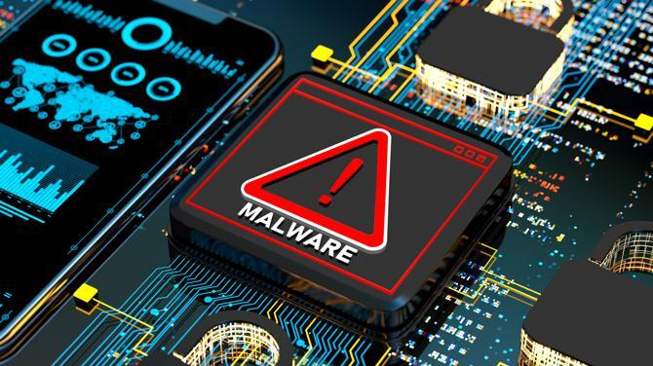
What is Malware?
Malware refers to malicious software designed to harm or exploit any programmable device, service, or network, often causing data loss or unauthorized access.

Slide 3
Types of Malware
Virus
Ransomware
Spreads by attaching to files.
Locks your files and demands payment.
Spyware
Trojans
Secretly tracks your activities.
Disguises itself as a normal program.
Worms
Keyloggers
Spreads without attaching to anything.
Records everything you type.

Slide 4
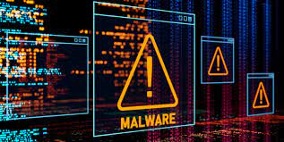
How Does Malware Spread?
Infected Attachments: Email files containing malware.
Compromised Websites: Clicking on malicious links.
Downloads: Installing infected programs.
USB Drives: Spreading through external devices.
Image: A map showing paths of infection (email, downloads, USB).
Example: If you download a fake game, the malware might sneak onto your system alongside it.

Slide 5
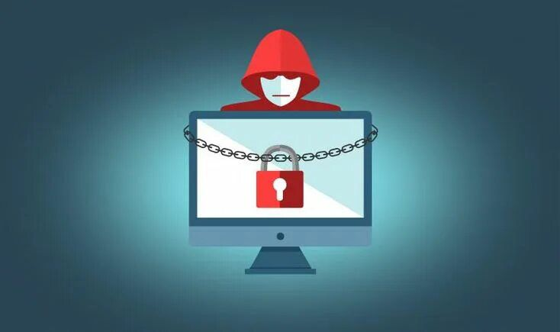
What Can Malware Do?
Steal personal information (e.g., passwords, credit card details)
Control your computer remotely without your knowledge
Damage or delete files
Disrupt or slow down your computer or network
Demand ransom (like with ransomware)

Slide 6
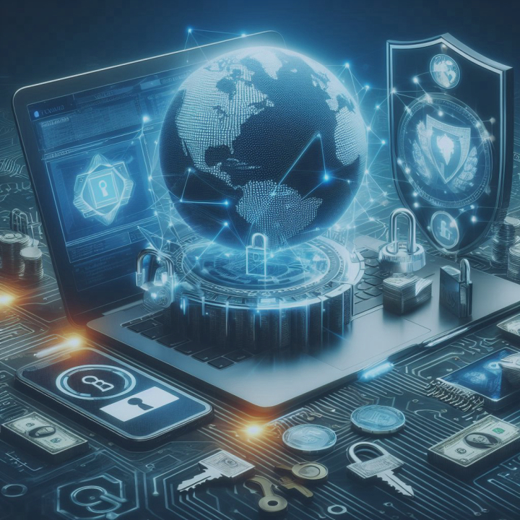
How to Protect Yourself
Use antivirus software
Keep software up to date
Be careful with downloads and emails
Back up your data
Use strong, unique passwords

Slide 7
Real-World Example 1 – WannaCry Ransomware Attack
Attack: In 2017, the WannaCry ransomware attack hit over 200,000 computers in 150 countries.
How It Spread: It used a vulnerability in Windows systems to infect machines and encrypt files, then demanded a ransom in Bitcoin.
Impact: Hospitals, businesses, and government institutions were severely disrupted.
Lesson: Always update software—WannaCry exploited an unpatched Windows vulnerability.

Slide 8
Real-World Example 2 – NotPetya Ransomware
Attack: The NotPetya attack in 2017 looked like ransomware but was actually designed to destroy data.
How It Spread: It used the same vulnerability as WannaCry but was aimed at maximum disruption, particularly in Ukraine.
Impact: Large corporations such as shipping giant Maersk, pharmaceutical
company Merck, and others experienced major losses, totaling billions.
Lesson: Even trusted-looking software (it spread via accounting software) can carry hidden threats.

Slide 9
Real-World Example 3 – The Stuxnet Worm
Attack: Stuxnet, a worm discovered in 2010, was designed to target and sabotage Iran’s nuclear program.
How It Spread: It spread via USB drives and targeted industrial control systems.
Impact: It specifically altered the functioning of centrifuges in Iran’s nuclear facilities, causing physical damage.
Lesson: Malware can be used for cyber warfare, targeting not just data but physical infrastructure.

Slide 10
Real-World Phishing Campaign – The 2016 Podesta Email Phishing Attack
Attack: In 2016, during the U.S. presidential campaign, John Podesta, a key figure in Hillary Clinton’s campaign, fell victim to a phishing attack.
How It Worked: Podesta received a fake email that looked like a Google alert for a password reset. When he clicked the link, it led to a fake Google login page, where his credentials were stolen.
Impact: The stolen emails were leaked to WikiLeaks, causing political embarrassment and disruption.
Lesson: Be cautious with unexpected password reset emails and always verify the source before entering credentials.

Slide 11
Real-World Phishing Campaign – Operation Phish Phry
Attack: Operation Phish Phry was a massive phishing campaign discovered by the FBI in 2009.
How It Worked: Criminals sent fake bank emails to U.S. and Egyptian citizens, tricking them into entering their online banking credentials on fake websites.
Impact: The criminals stole millions of dollars from compromised accounts. It resulted in the largest cybercrime investigation at the time, with over 100 arrests.
Lesson: Never click on suspicious links in bank emails and always verify websites before entering sensitive information.

Slide 12
Conclusion
Recap: Malware is a serious digital threat that can steal, damage, and disrupt systems. By understanding its types and how it spreads, you can take steps to protect yourself.
Key Takeaway: Stay vigilant, keep your software updated, and use protective measures.

